Slide 1
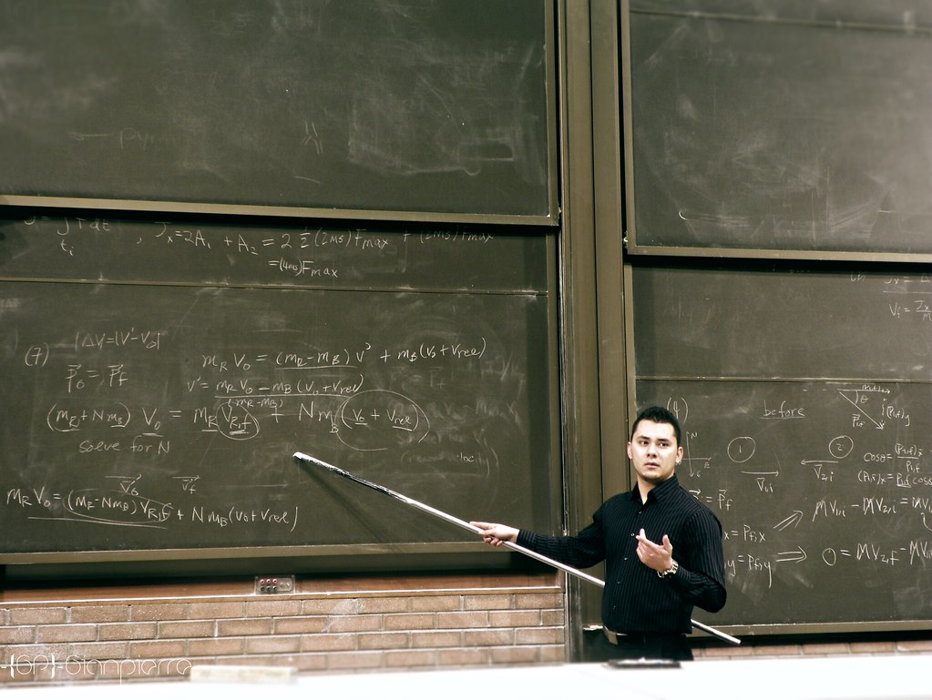
Tips for teaching as a PhD student
"The Apprentice" by Gianpierre Soto is licensed under CC BY-NC 2.0

Slide 2
What is teaching all about?

Slide 3
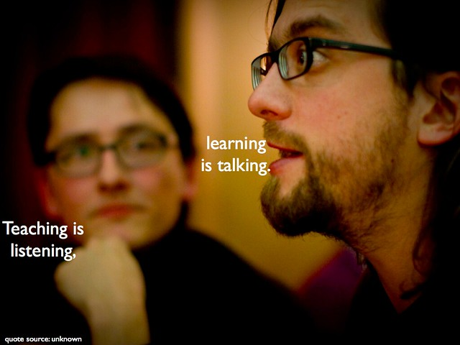
Tips for teaching as a PhD student
"Teaching is listening, learning is talking" by Darren Kuropatwa is licensed under CC BY-NC-SA 2.0
"The Apprentice" by Gianpierre Soto is licensed under CC BY-NC 2.0

Slide 4
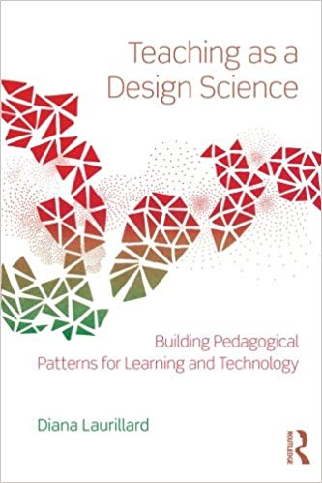
https://biblos.kau.se/record=b1692633~S1*swe

Slide 5
Think about a lecture of your undergraduate studies that you remember.
What did your teacher do? What did you do?

Slide 6

Need pictures?
Notes:
We all know that we should do it – but where to find them?
Short answer – 1 million pictures
Long answer – 100 million+ pictures, how to integrate them in seconds in your ppt, learn abt cc

Slide 7
unsplash.com
pixabay.com
https://www.slideshare.net/joergelp/need-pictures

Slide 8
Teaching as a PhD student
You can do it!
Work within your hours
https://www.ashleighjohnstone.com/post/teaching-as-a-phd-student
https://www.ashleighjohnstone.com/post/teaching-as-a-phd-student-marking

Slide 10
Applicable laws and decrees
Chap 1. Art 1 Instrument of Government→ the public power is exercised under the laws.
Chap 1 art 9 Instrument of Government→ principle of objectivity
Administrative Procedure Act
Higher Education Act
Higher Education Ordinance
Notes:
This so-called the principle of legality means that the administrative authorities must have constitutional support for their decision-making rights. In Chapter 1 Section 9 of the Instrument of Government is stated as follows: Courts and administrative authorities and others who fulfill public administration tasks shall, in their activities, consider everyone's equality before the law and observe factual and impartiality. This section contains an principle of objectivity which, among other things, means that administrative authorities, such as universities and colleges, must not be influenced by a desire to favor or disadvantage other interests. Nor should they take into account extraneous circumstances, such as an applicant's origin or political opinion
The Procedure Act, I will return to immediately The Higher Education Act contains provisions for universities that have the state as principal. There it appears, for example, that students should have the right to influence and that universities and higher education institutions should cooperate with the surrounding society The Higher Education Ordinance is a regulation adopted by the Swedish Government. It is subject to the Higher Education Act. it complements the Higher Education Act and regulates, among other things, the composition of the board, employment and general rules for higher education undergraduate and graduate level. Here too, the state as principal.

Slide 11
http://intra.kau.se/dokument/upload/C10B9428056c925BEBWUFE4667F6/C2017_188grundutbregler_rev.pdf

Slide 12
jurist@kau.se

Slide 13
upe@kau.se

Slide 14
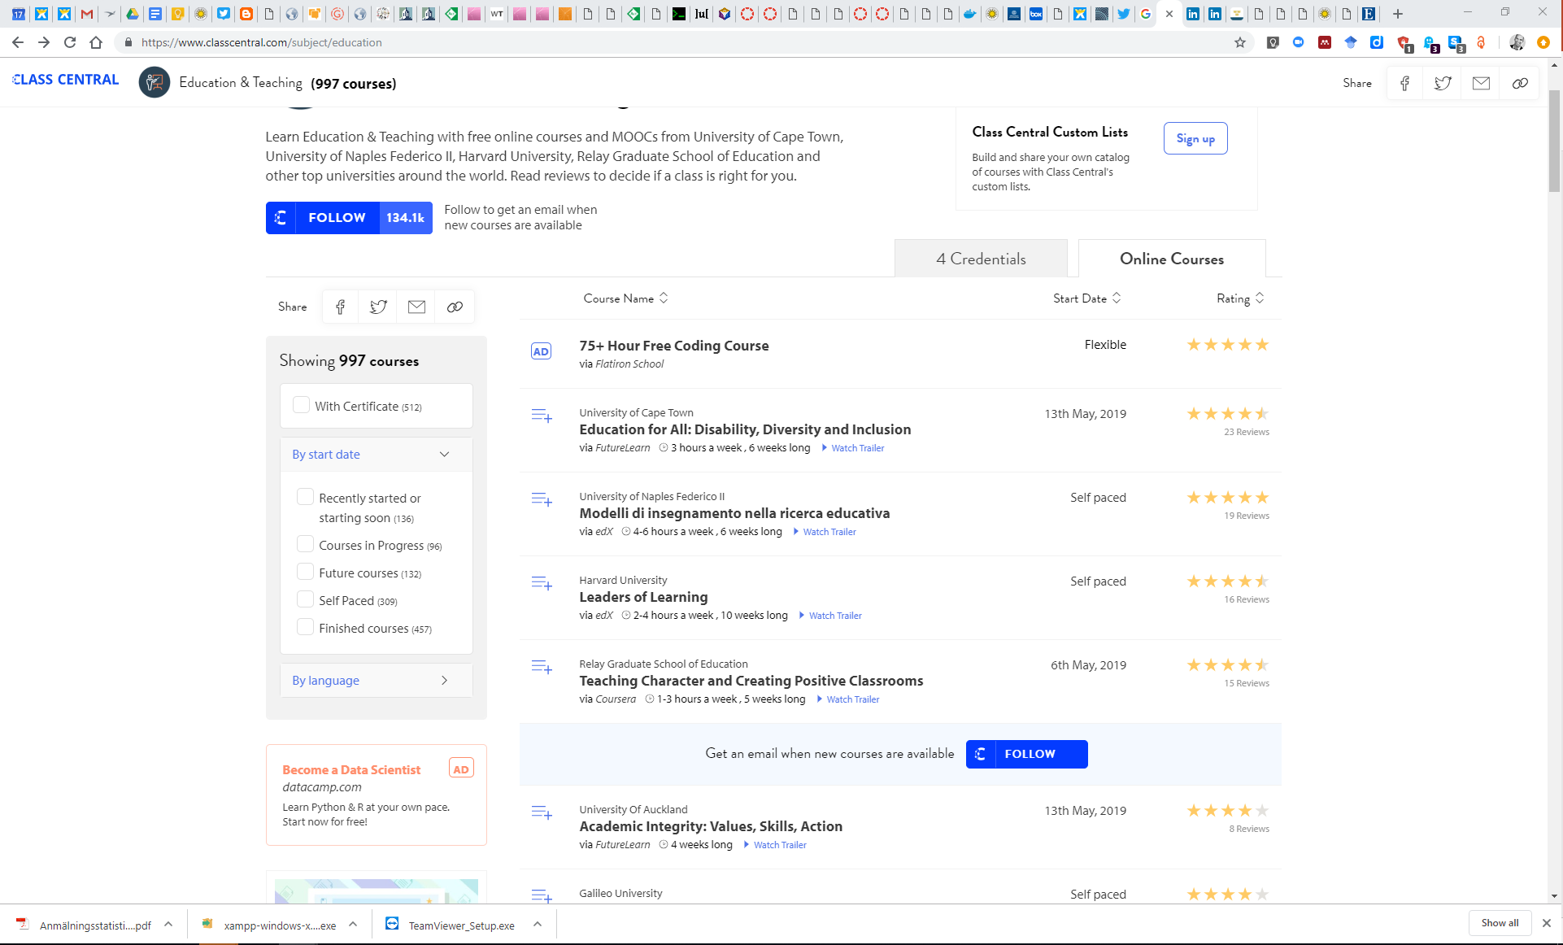
jurist@kau.se

Slide 15

hhk3.kau.se

Slide 16
1234567891011121314151617181920212223242526

Slide 17
ABCDEFGHIJKLMNOPQRSTUVWXYZ

Slide 18
1234567891011121314151617181920212223242526
ABCDEFGHIJKLMNOPQRSTUVWXYZ
A1B2C3D4E5…..

